Slide 1
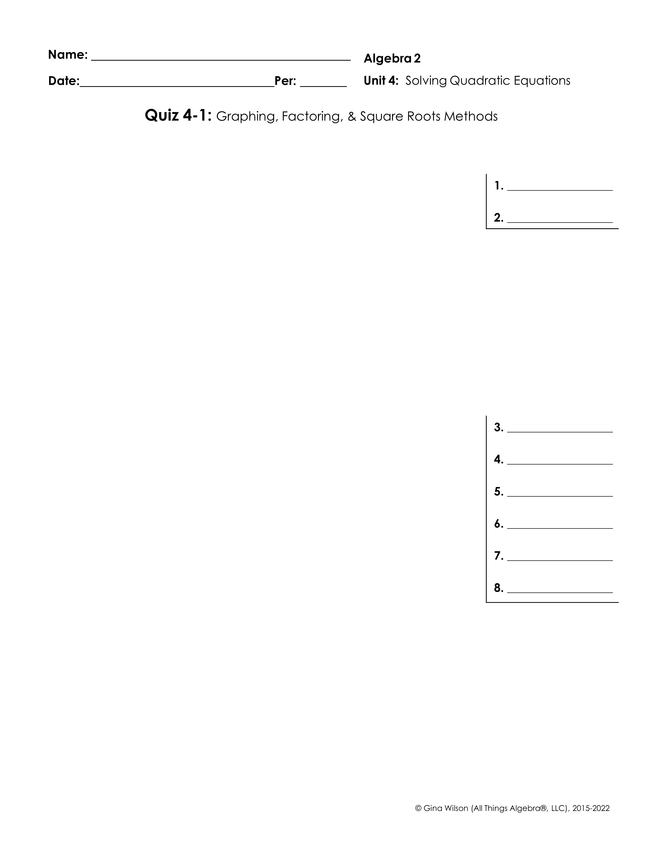
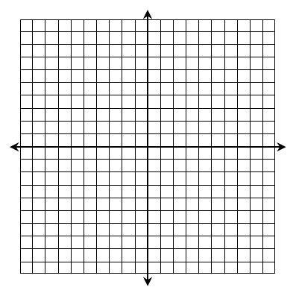
For questions 1-2, find the roots of the function by graphing.
1.
2.
For questions 3-12, solve by factoring.
3.
4.
5.
6.
7.
8.

Slide 2
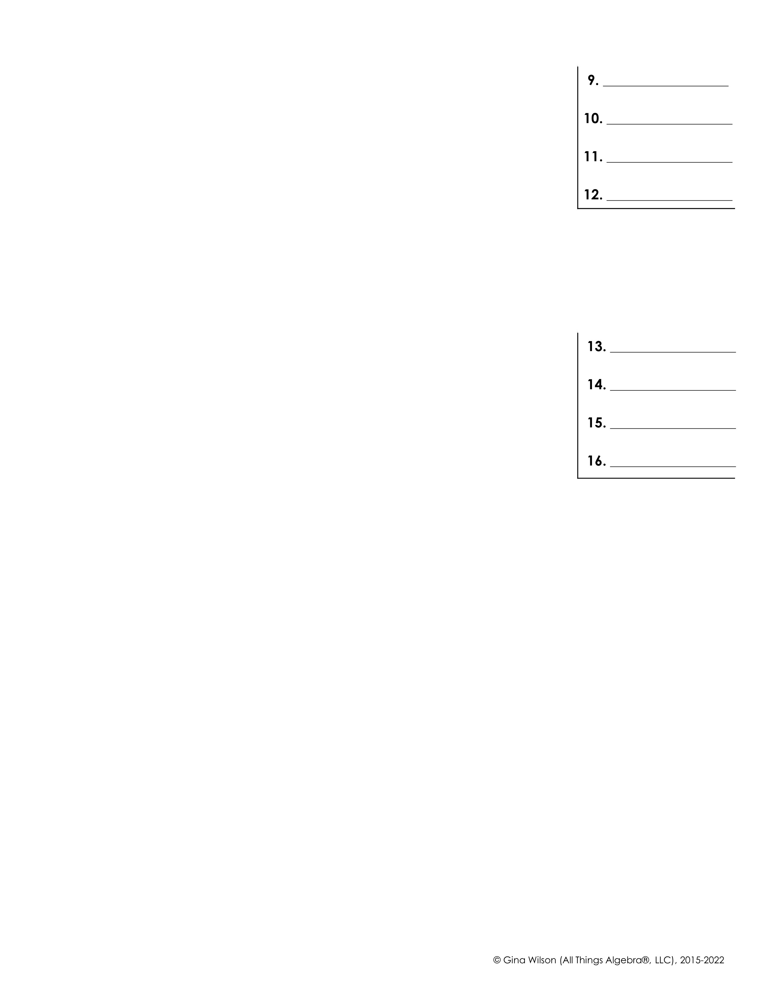
9.
10.
11.
12.
For questions 13-16, solve using the square roots method. Write answers in simplest radical form.
13.
14.
15.
16.
17. Write the function below in factored form and identify the axis of symmetry, vertex, and roots.
Factored Form:
Axis of Symmetry: | Vertex:
Roots:
18. Write the function below in vertex form and identify the axis of symmetry, vertex, and roots.
Vertex Form:
Axis of Symmetry: | Vertex:
Roots:

